Slide 1
UK Volkswagen Used Car Analysis
Date: August 18th, 2020
Presenter: Derick Lai

Slide 2
Introduction
My name is Derick Lai, and currently work for the UK Branch of Volkswagen Group, as a data analyst. We have set out some plans to develop some market research in comparing the prices of the used car market, in particular with all the variety of different models being listed in the market.
With the current economic downturn due to the pandemic, we are forecasting lower sales for the foreseeable future, and want to plan financially to keep our car prices stable with respect to the changing market. The mission of this project is to analyze the UK market to recognize any patterns that we can make use of as we plan for a potential market contraction.
We are looking to find out the average prices of all vehicle models in the pre-owned market and discover any disparities that may be useful for new car sales. Additionally we looked to create a predictive model for the UK based market.

Slide 3
Dataset Variables
Model: VW Vehicle Model (Categorical)
Car Fuel Type: Diesel, Hybrid, Petrol, Other (Categorical)
Transmission: Auto, Semi-Auto, Manual (Categorical)
Price: Cost of Vehicle to be sold
Mileage: Miles accrued of Vehicle
Tax: UK tax on vehicle when sold
MPG: Fuel economy rating of vehicle
Engine Size: Size rating of vehicle
Year: VW Vehicle model year

Slide 4
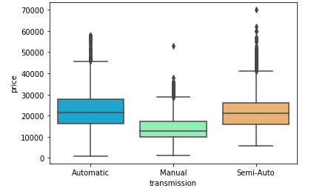
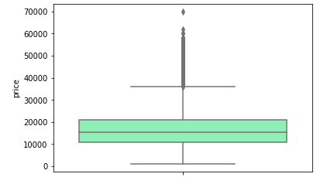
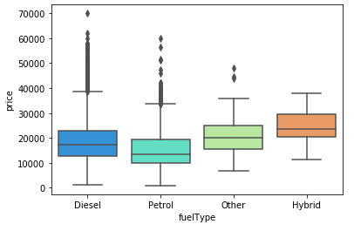
Descriptive Statistics: Box Plots
All box plots are being compared to how the price will be affected as the dependent variable
Automatic and Semi-Auto transmission vehicles seem to have similar price values, where manual is the lowest
Hybrids of all fuel types cost the most. Petrol is the least expensive.

Slide 5
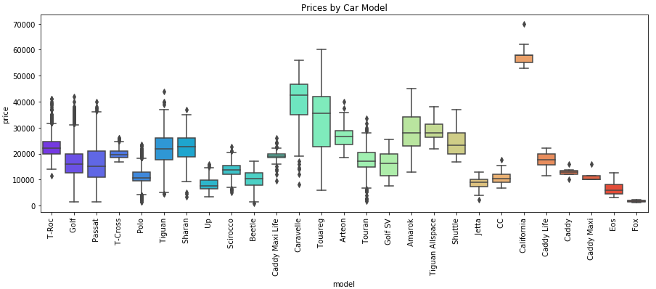
Descriptive Statistics: Box Plots
List of 27 Volkswagen vehicle models listed for sale in the Pre-Owned market. Model years from 2000 – 2020.
Models California and Caravelle lead as the highest priced cars. Models such as Caddy, Eos, and the Fox round out the least expensive models.

Slide 6
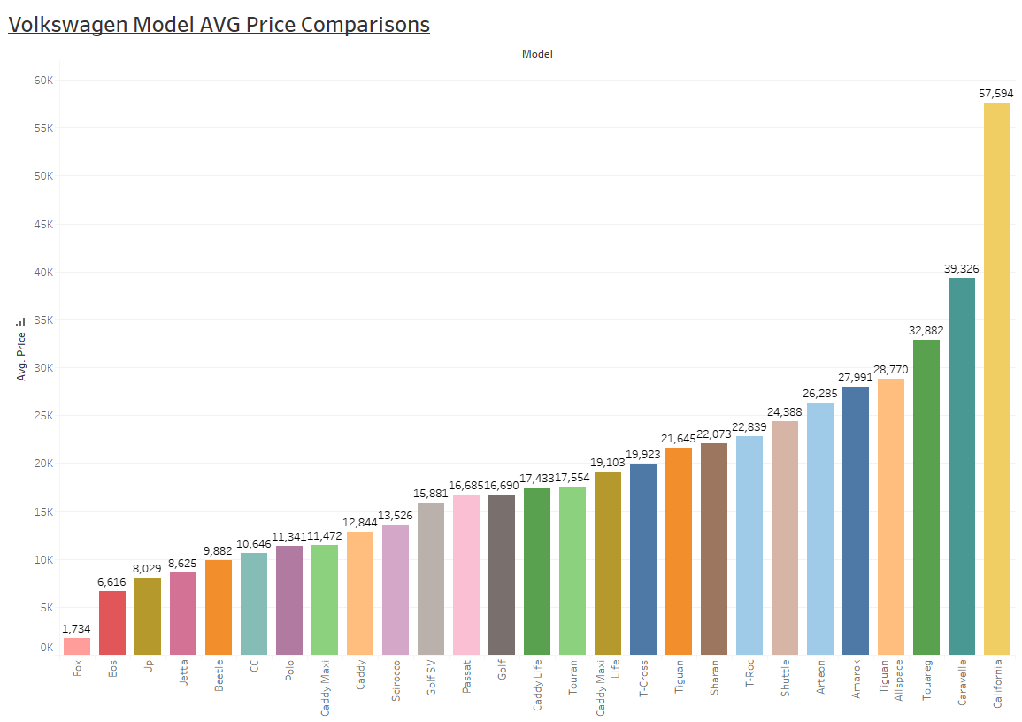
Bar Chart – Ascending AVG Price
Here we listed out in ascending order, the average price of all model vehicles. As noted in the previous slide, Fox represents the lowest average priced car while California tops the list as the highest average priced car.

Slide 7
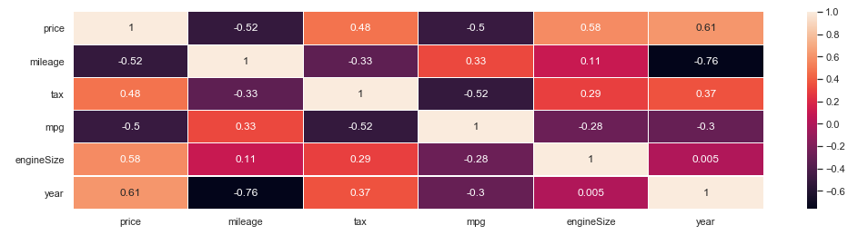
Heat Map: Finding Correlation
We initiated a heatmap to discover any strong connections to the price of our UK Car Models. A correlation matrix was developed to observe any links of the price with mileage, tax, mpg, engine size, and the model year.
Across the board, we discovered that price had some strong relationships, both positive and negative with the variables. In particular price correlated the most with Year at 0.61, meaning that as the model year is higher (i.e. car is a newer model), the price will be higher.

Slide 8
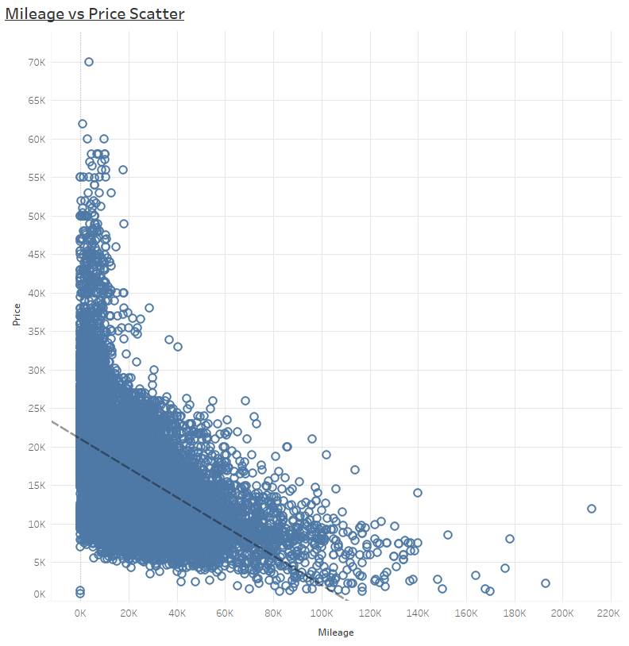
Scatter Plots
Seeing as we had 4 variables with a decent correlation with the vehicle price, we mapped out scatter plots to map out the relationships, whether positive or negative correlation.
As mileage increases so does the price when it comes to the vehicle price. It is interesting to note that the bulk of the values lie below the 100,000 mileage mark, with a few outliers hovering above higher values such as 120,000.
The R is -0.52

Slide 9
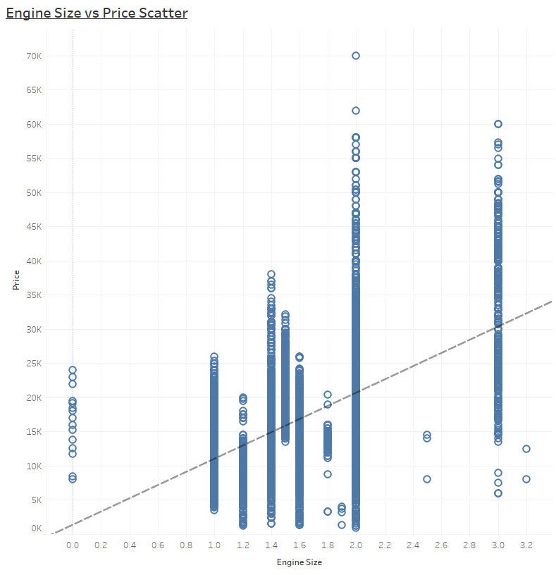
Scatter Plots
Next we take a look at Engine Size vs Price, with the two variables having a positive correlation.
As engine size increases so does the vehicle price. The bulk of the engine sizes seem to range from 1 to 2, with approximately a 1/3rd of the values being engine size 3. Perhaps a bigger engine size warrants a higher sell price due to higher production costs.
The R is 0.58

Slide 10
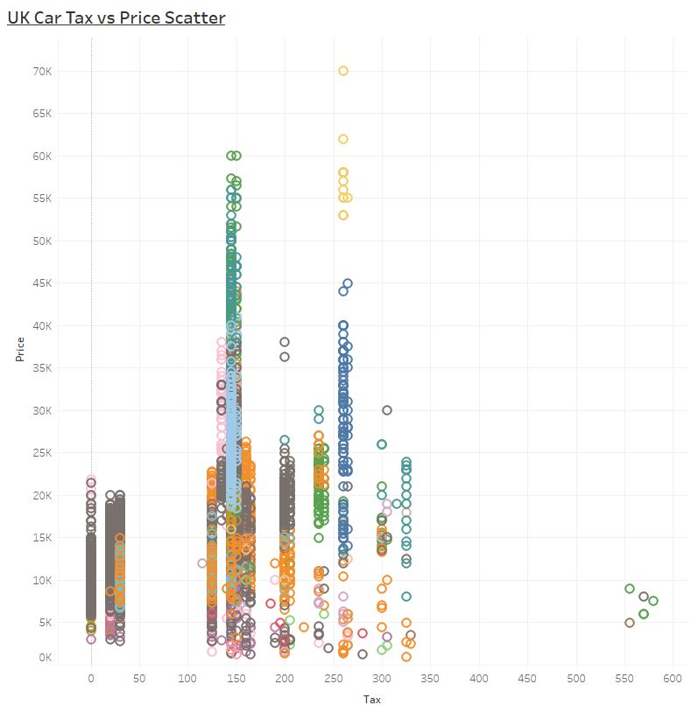
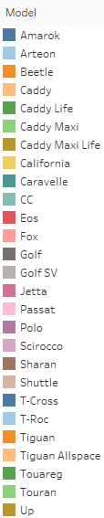
Scatter Plots
Now, we take a look at UK Car Sales Tax vs Price, with the two variables having a positive correlation.
As the car sales tax increases so does the vehicle price. In comparison to other countries, the UK initiates a fee per car sale. The car tax values look to be more static with set regulated prices. Further analysis is warranted as to what determines the car sales tax calculation.
The R is 0.48

Slide 11
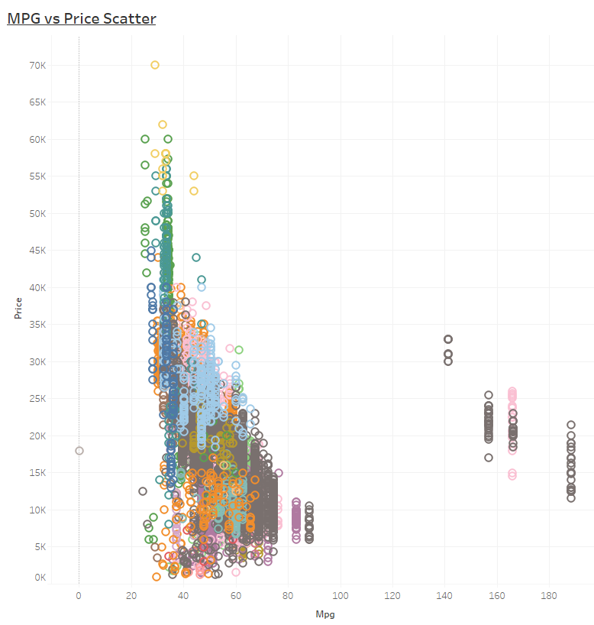
Scatter Plots
Lastly, we take a look at MPG (fuel economy) vs Price, with the two variables having a negative correlation.
As the MPG increases the vehicle price decreases. The spread of data skewing towards the lower MPG values may be due to the prevalence of Hybrid vehicles in the data set, which mostly consist of lower MPG models.
The R is -0.5

Slide 12
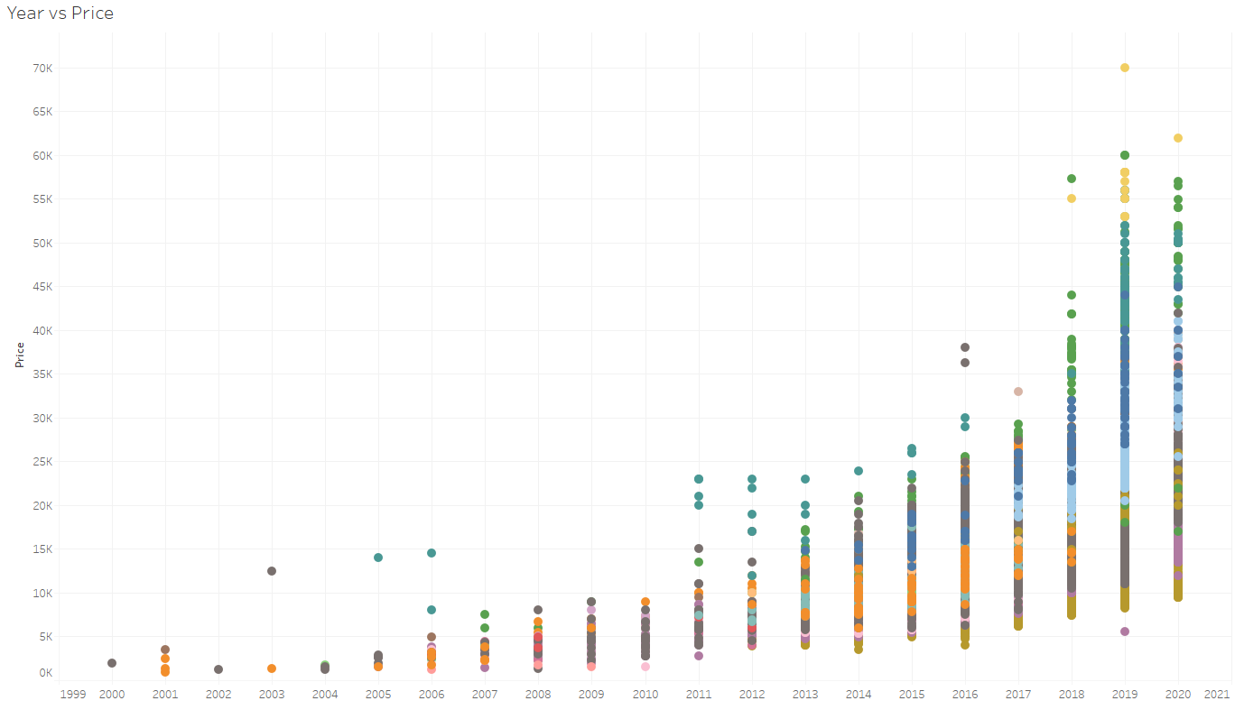
Scatter Plots
Lastly, we take a look at Year vs Price, with the two variables having a positive correlation.
As the Year increases the vehicle price decreases. This makes sense as higher the year, means newer the car model. Newer vehicles, even pre-owned will generally sell at a higher price compared to older models of the same make. The R is 0.61

Slide 13
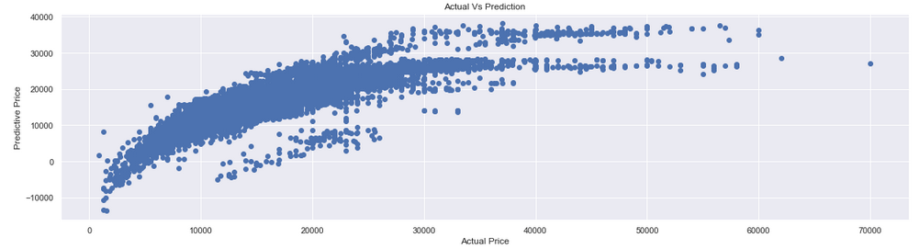
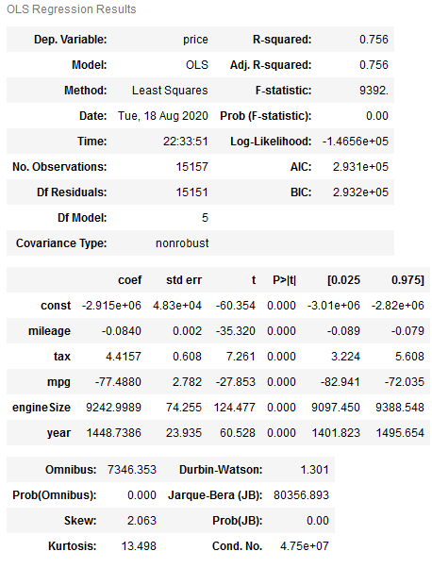
OLS Regression
A multivariate predictive model was created with the help of Python, utilizing an OLS Regression. The regression equation that models the vehicle Price against all other independent variables (Year, Engine Size, Mileage, MPG, Car Sales Tax)
The R-squared of the model is 0.756, signifying a created model a strong predictor of car price when plotted against the other variables. The model seems to work best for Actual Price values ranged from 10,000 to 30,000.
Notes:
Regression is the “best line of fit”, straight line across and all points fit on the line = good fit
Points far away from the line = not a good fit
Rationale, so we know an increase in “a” increases our “price” by how much. Will help in quantifying independent variables (drivers) and how it potentially drives dependent variable.

Slide 14
Summary of Findings
All the following variables correlated strongly with the price of pre-owned vehicles of Volkswagen model cars, sold in the UK: MPG, Year, Mileage, Car Sales Tax, and Engine Size
The highest AVG car price and lowest AVG car price were represented by VW models California ($57,000) and Fox ($1700). Further research will be required to determine if there any other factors affecting such a disparity in price.
For example, are there models that have been discontinued in years earlier than some of the newer cars in the data set? Were there any defects or car reviews / safety ratings that would negatively affect the reputation of a car, leading to a lower demand and market price?
It would be interesting to compare the data we have on UK used car sales with other VW distribution and sale centers from nearby European markets as well.

Slide 15
Dataset:
https://www.kaggle.com/adityadesai13/used-car-dataset-ford-and-mercedes
Any questions?
Please feel free to contact me at:
dericklai.lai@gmail.com
Notes:
Feedback:
- Ask questions back to guests / viewers. Allows you to interact with the interviewers. Tell a story, discuss with stakeholders.
Toggle between presentation tools – Consider using static visuals on the Powerpoint and then alt tab into Tableau / Dashboard to interact, filter. Different maps , zoom in, etc.
Important to keep it dynamic – shows you have the skills and determination to put thought into the visuals.

